Slide 1
Title: Event Management System
Presented by: 1. Muizz Khan (F2023376059) 3. Samra Tahir (F2023376295) 2. Aliza Zainab (F2023376320) 4. Rahim Khan(F2023376046)
Purpose: To manage and organize event-related large data including clients, venues, staff, services, and bookings, for better management.
Tools Used: MySQL Workbench

Slide 2
Entity-Relationship Summary
Main Tables:
Client – Stores client details
Event – Links to Client (client_id)
Venue – Stores venue details
Booking – Links Event & Venue
Service – List of available services
Event_Service – Many-to-many (Event ↔ Service)
Staff – Staff info
Event_Staff – Many-to-many (Event ↔ Staff)

Slide 3
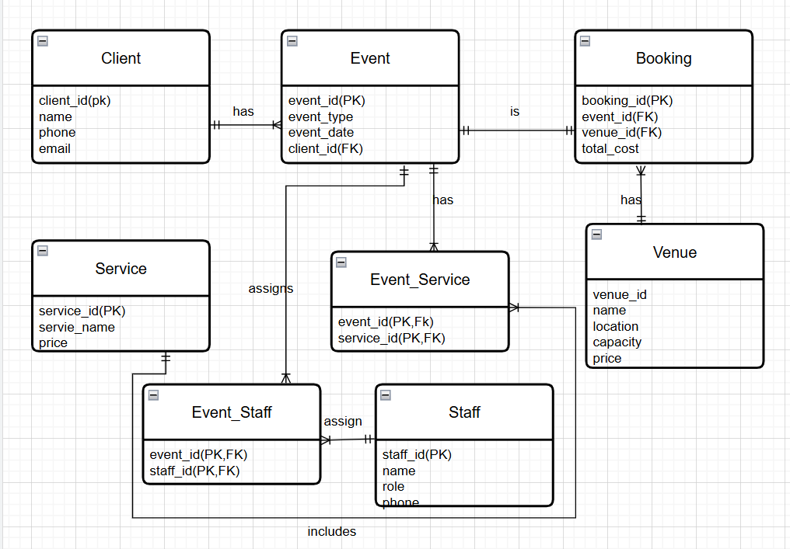
ERD DIAGRAM (Crow Foot)

Slide 4
RELATIONAL SCHEMA
CLIENT(Client_ID [PK], Name, Phone, Email)
EVENT(Event_ID [PK], Event_Type, Event_Date, Client_ID [FK] → CLIENT(Client_ID))
VENUE( Venue_ID [PK], Name, Location, Capacity, Price)
BOOKING(Booking_ID [PK], Event_ID [FK] →EVENT(Event_ID),Venue_ID [FK] → VENUE(Venue_ID), Total_Cost)
SERVICE( Service_ID [PK], Service_Name, Price)
EVENT_SERVICE(Event_ID [PK] [FK] → EVENT(Event_ID),Service_ID [PK] [FK] → SERVICE(Service_ID))
STAFF(Staff_ID [PK],Name, Role, Phone))
EVENT_STAFF( Event_ID [PK] [FK] → EVENT(Event_ID), Staff_ID [PK] [FK] → STAFF(Staff_ID))

Slide 5
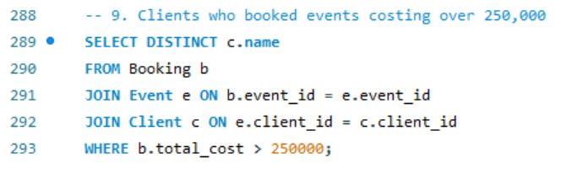
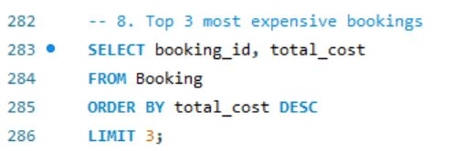
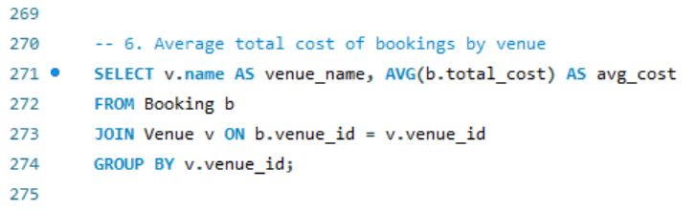
Some Example Queries:

Slide 6
Any Questions?

